Slide 1
Chapter 8: Single-Area OSPF
Routing Protocols
Notes:
Cisco Networking Academy program
Routing Protocols
Chapter 8

Slide 2
8.1 Characteristics of OSPF
Notes:
8.1.1.1

Slide 3
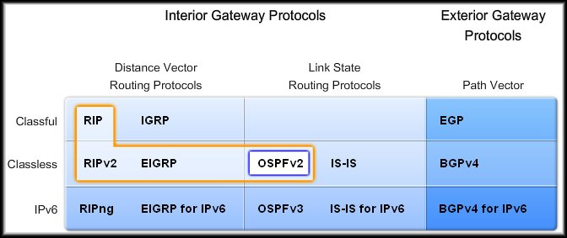
Characteristics of OSPF
OSPF is a classless, link-state routing protocol that uses the concept of areas for scalability.
RFC 2328 defines the OSPF metric as an arbitrary value called cost.
Cisco IOS software uses bandwidth to calculate the OSPF cost metric.

Slide 4
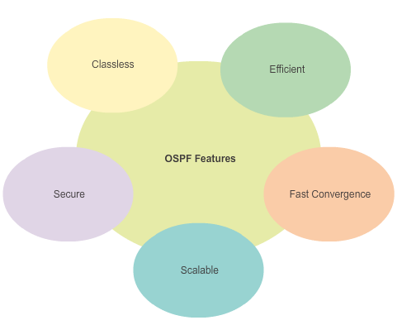
Open Shortest Path First Features of OSPF
Classless - It is classless by design; therefore, it supports VLSM and CIDR.
Efficient - Routing changes trigger routing updates (no periodic updates). It uses the SPF algorithm to choose the best path.
Fast convergence - It quickly propagates network changes.
Scalable - It works well in small and large network sizes. Routers can be grouped into areas to support a hierarchical system.
Secure - It supports Message Digest 5 (MD5) authentication. When enabled, OSPF routers only accept encrypted routing updates from peers with the same pre-shared password.
Notes:
8.1.1.2

Slide 5
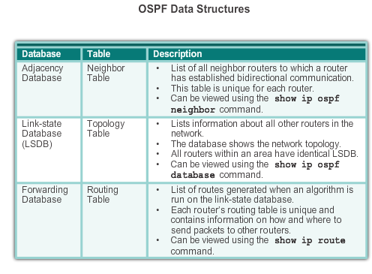
Open Shortest Path First Components of OSPF
OSPF creates and maintains three databases:
Adjacency database Creates the neighbor table
Link-state database (LSDB) - Creates the topology table
Forwarding database - Creates the routing table
Notes:
8.1.1.3

Slide 6
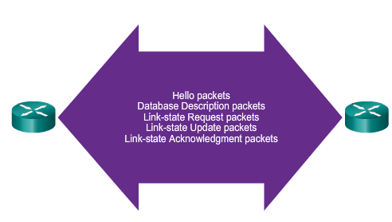
Open Shortest Path First Components of OSPF
OSPF Routers Exchange Packets - These packets are used to discover neighboring routers and also to exchange routing information to maintain accurate information about the network.
Notes:
8.1.1.3

Slide 7
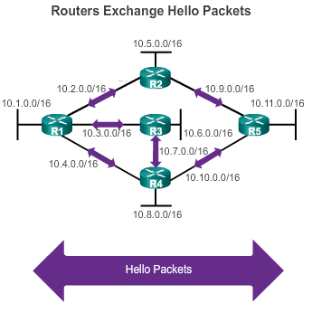
Open Shortest Path First Link-State Operation
If a neighbor is present, the OSPF-enabled router attempts to establish a neighbor adjacency with that neighbor
Notes:
8.1.1.4

Slide 8
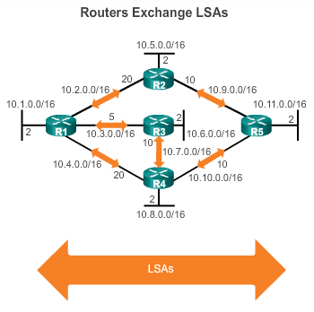
Open Shortest Path First Link-State Operation
LSAs contain the state and cost of each directly connected link.
Routers flood their LSAs to adjacent neighbors.
Adjacent neighbors receiving the LSA immediately flood the LSA to other directly connected neighbors, until all routers in the area have all LSAs.
Notes:
8.1.1.4

Slide 9
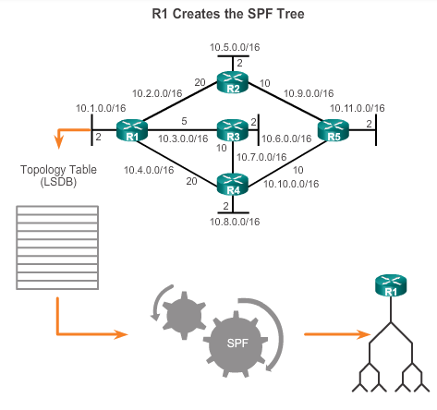
Open Shortest Path First Link-State Operation
Build the topology table based on the received LSAs.
This database eventually holds all the information about the topology of the network.
Execute the SPF Algorithm.
Notes:
8.1.1.4

Slide 10
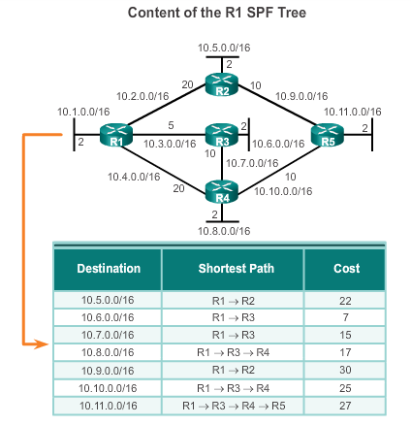
Open Shortest Path First Link-State Operation
From the SPF tree, the best paths are inserted into the routing table.
Notes:
8.1.1.4

Slide 11
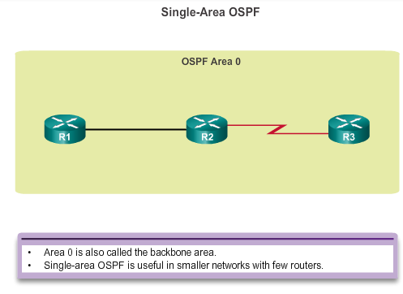
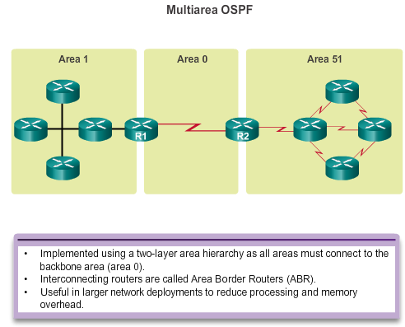
Open Shortest Path First Single-area and Multiarea OSPF
OSPF can be implemented in one of two ways:
Notes:
8.1.1.5

Slide 12
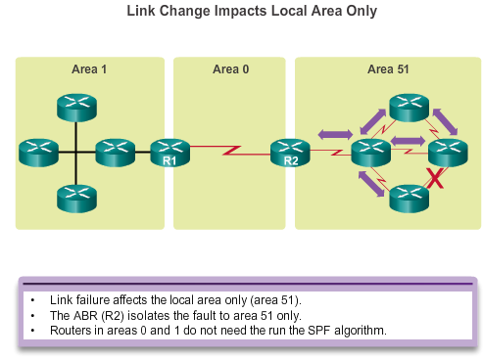
Open Shortest Path First Single-area and Multi area OSPF
Multi area OSPF have advantages:
Smaller routing tables - Fewer routing table entries because network addresses can be summarized between areas. Route summarization is not enabled by default.
Reduced link-state update overhead - Minimizes processing and memory requirements.
Reduced frequency of SPF calculations - Localizes the impact of a topology change within an area. For instance, it minimizes routing update impact because LSA flooding stops at the area boundary.
Notes:
8.1.1.5

Slide 13
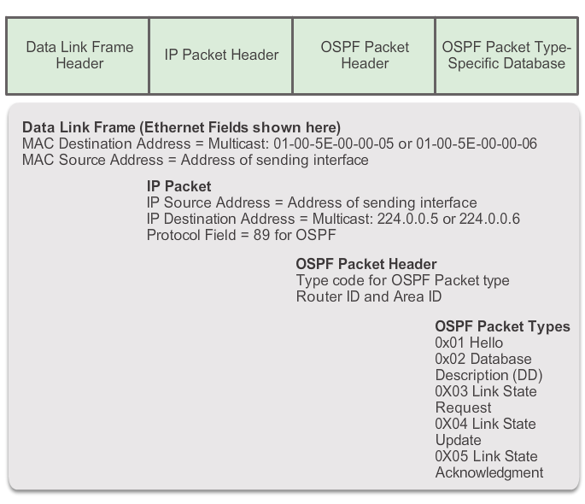
OSPF Messages Encapsulating OSPF Messages
OSPF messages transmitted over a link contain the following information:
Notes:
8.1.2.1

Slide 14
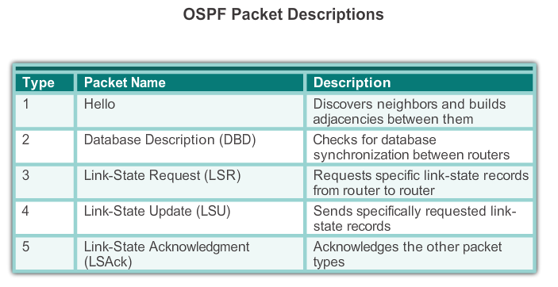
OSPF Messages Types of OSPF Packets
OSPF uses link-state packets (LSPs) to establish and maintain neighbor adjacencies and exchange routing updates.
The figure shows the five different types of LSPs used by OSPF. Each packet serves a specific purpose in the OSPF routing process:
Notes:
8.1.2.2

Slide 15
OSPF Messages Hello Packet
OSPF Type 1 packet = Hello packet
Discover OSPF neighbors and establish neighbor adjacencies
Advertise parameters on which two routers must agree to become neighbors (Hello/Dead timer)
Elect the Designated Router (DR) and Backup Designated Router (BDR) on multi access networks like Ethernet and Frame Relay (see later)
Uses 224.0.0.5 in IPv4 and FF02::5 in IPv6 (multicast all OSPF routers)
Hello Time: Every 10 seconds (default on multiaccess and point-to-point networks). Every 30 seconds (default on non-broadcast multi access networks)
Dead interval is the period that the router waits to receive a Hello packet before declaring the neighbor down. Cisco’s default is 4 times the Hello interval (40 sec)
Notes:
8.1.2.3

Slide 16
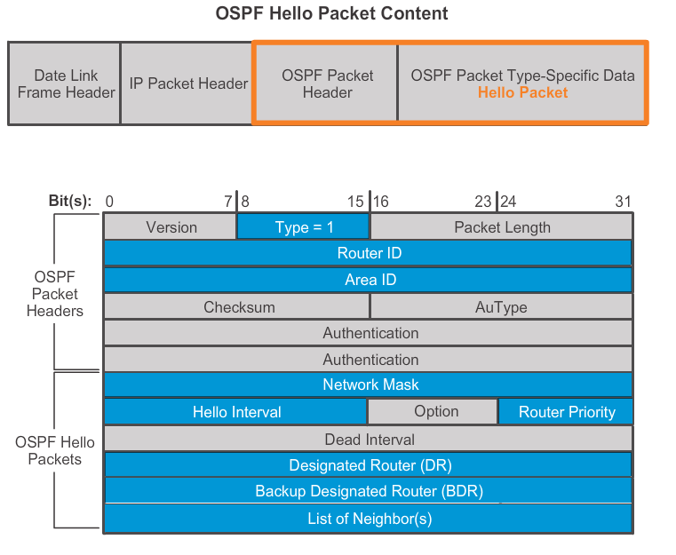
OSPF Messages Hello Packet
Notes:
8.1.2.3

Slide 17
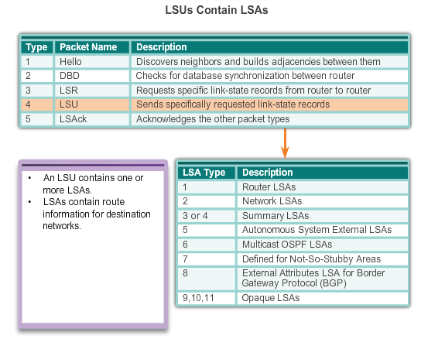
OSPF Messages Link-State Updates
LSUs are used to forward OSPF routing updates, such as link changes. Specifically, an LSU packet can contain 11 different types of OSPFv2 LSAs, as shown in the figure. OSPFv3 renamed several of these LSAs and also contains two additional LSAs.
Notes:
8.1.2.5

Slide 18
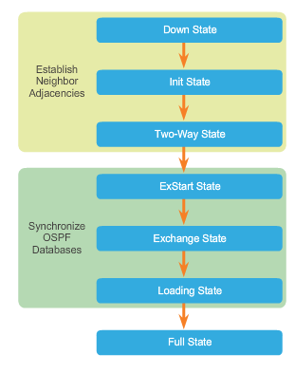
OSPF Operation OSPF Operational States
When an OSPF router is initially connected to a network, it attempts to:
Create adjacencies with neighbors
Exchange routing information
Calculate the best routes
Reach convergence
OSPF progresses through several states while attempting to reach convergence.
Notes:
8.1.3.1

Slide 19
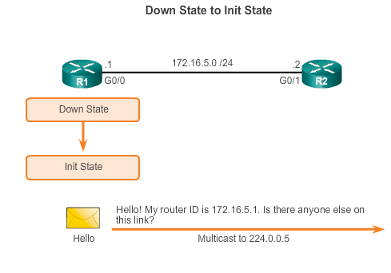
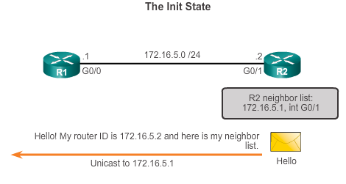
OSPF Operation Establish Neighbor Adjacencies
Refer to R1. When OSPF is enabled, the enabled Gigabit Ethernet 0/0 interface transitions from the Down state to the Init state. R1 starts sending Hello packets out all OSPF-enabled interfaces to discover OSPF neighbors to develop adjacencies with.
R2 receives the Hello packet from R1 and adds the R1 router ID to its neighbor list. R2 then sends a Hello packet to R1. The packet contains the R2 Router ID and the R1 Router ID in its list of neighbors on the same interface.
Notes:
8.1.3.2

Slide 20
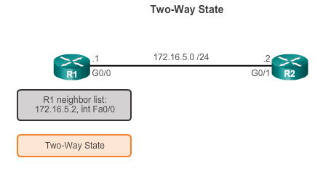
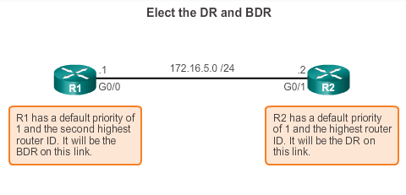
OSPF Operation Establish Neighbor Adjacencies
R1 receives the R2 Hello and adds the R2 Router ID to its list of neighbors. It also notices its own Router ID in the R2’s Hello packet’s list of neighbors. When a router receives a Hello packet with its Router ID listed in the list of neighbors, the router transitions from the Init state to the Two-Way state.
The action performed in Two-Way state depends on the type of inter-connection between the adjacent routers:
If the two adjacent neighbors are interconnected over a point-to-point link, then they immediately transition from the Two-Way state to the database synchronization phase.
If the routers are interconnected over a common Ethernet network, then a designated router DR and a BDR must be elected.
Hello packets are continually exchanged to maintain router information.
DR and BDR election only occurs on multi-access networks such as Ethernet LANs.
Notes:
8.1.3.2

Slide 21
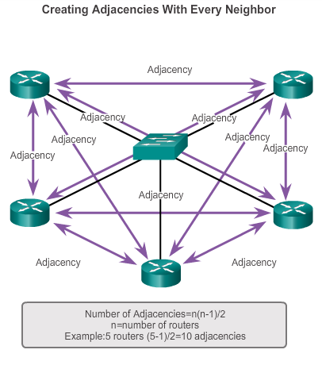
OSPF Operation OSPF DR and BDR
The creation of an adjacency between every pair of routers in a network would cause the number of adjacencies to grow exponentially.
To reduce the amount of OSPF traffic on multi-access networks, OSPF elects a Designated Router (DR) and Backup Designated Router (BDR).
Notes:
8.1.3.3

Slide 22
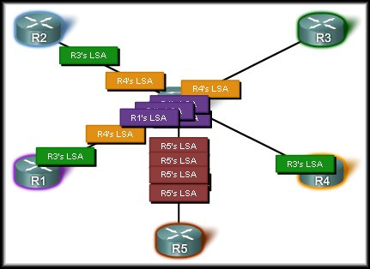
Multiple Adjacencies
Animation 8.1.3.3
Link-state routers flood their link-state packets when OSPF is initialized or when there is a change in the topology.
This would lead to an excessive number of LSAs.

Slide 23
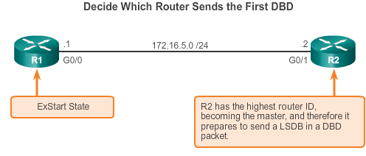
OSPF Operation Synchronizing OSPF Database
After the Two-Way state, routers transition to database synchronization states. While the Hello packet was used to establish neighbor adjacencies, the other four types of OSPF packets are used during the process of exchanging and synchronizing LSDBs.
A master and slave relationship is created between each router and its adjacent DR and BDR. The router with the higher router ID acts as the master for the Exchange state.
Notes:
8.1.3.4

Slide 24
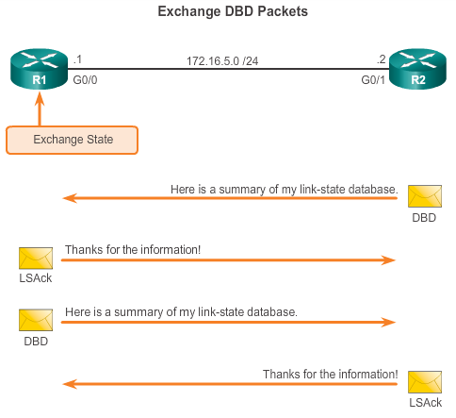
OSPF Operation Synchronizing OSPF Database
R2 sends a DBD packet to R1. When R1 receives the DBD, it performs the following actions:
It acknowledges the receipt of the DBD using the LSAck packet.
R1 then sends DBD packets to R2.
R2 acknowledges R1.
R1 compares the information received with the information it has in its own LSDB. If the DBD packet has a more current link-state entry, the router transitions to the Loading state.
Notes:
8.1.3.4

Slide 25
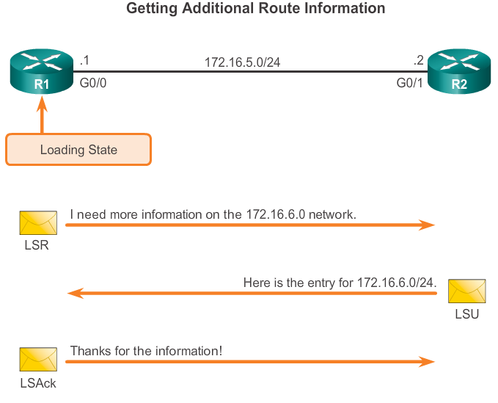
OSPF Operation Synchronizing OSPF Database
R1 sends an LSR regarding network 172.16.6.0 to R2. R2 responds with the complete information about 172.16.6.0 in an LSU packet.
Again, when R1 receives an LSU, it sends an LSAck. R1 then adds the new link-state entries into its LSDB.
After all LSRs have been satisfied for a given router, the adjacent routers are considered synchronized and in a full state.

Slide 26
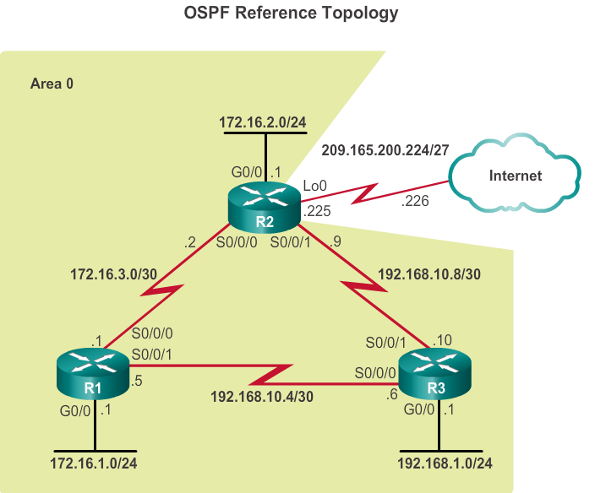
8.2 Configuring Single-area OSPFv2
Notes:
8.2

Slide 27
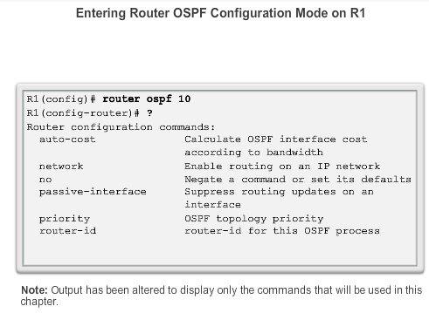
OSPF Router ID OSPF Network Topology
The process-id value represents a number between 1 and 65,535 and is selected by the network administrator. The process-id value is locally significant, which means that it does not have to be the same value on the other OSPF routers to establish adjacencies with those neighbors.
Notes:
8.2.1.2

Slide 28
OSPF Router ID Router IDs
Every router requires a unique router ID to participate in an OSPF domain. The router ID can be defined by an administrator or automatically assigned by the router. A Router ID is simply an IP address
The router ID is used by the OSPF-enabled router to:
Uniquely identify the router - The router ID is used by other routers to uniquely identify each router within the OSPF domain and all packets that originate from them.
Participate in the election of the DR
Cisco routers derive the router ID based on three criteria and with the following precedence:
Use the IP address configured with the OSPF router-id command.
If the Router ID is not configured, the router chooses the highest IP address of any of its loopback interfaces.
If no loopback interfaces are configured, the router chooses the highest active IP address of any of its physical interfaces.

Slide 29
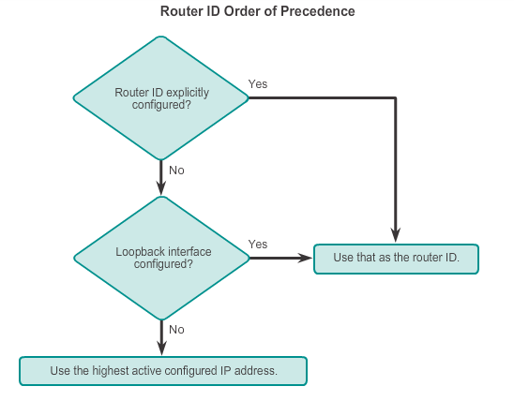
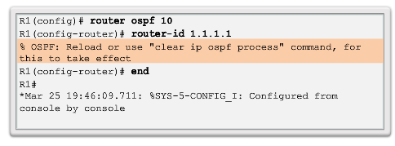
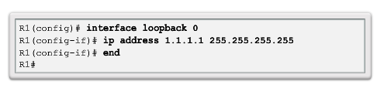
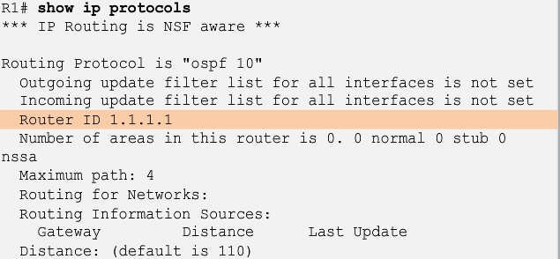
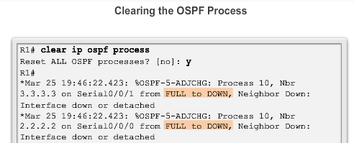
OSPF Router ID Router IDs
Notes:
8.2.1.3/4/5/6

Slide 30
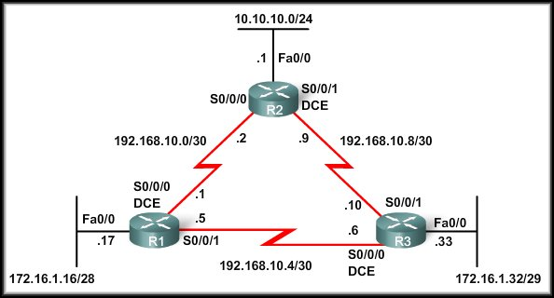
OSPF Router ID: Highest Active IP Address
10.10.10.1 192.168.10.2 192.168.10.9
172.16.1.17 192.168.10.1 192.168.10.5
172.16.1.33 192.168.10.6 192.168.10.10
Because we have not configured Router IDs or loopback interfaces on our three routers, the Router ID for each router is determined by the third criterion in the preceding list.
The highest active IP address on any of the router’s physical interfaces.

Slide 31
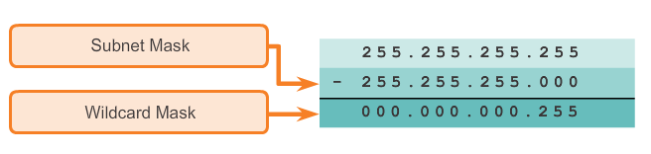
Wildcard mask
OSPFv2 uses the argument combination of network-address wildcard-mask to enable.
A wildcard mask is a string of 32 binary digits used by the router to determine which bits of the address to examine for a match. In a subnet mask, binary 1 is equal to a match and binary 0 is not a match. In a wildcard mask, the reverse is true:
Wildcard mask bit 0 - Matches the corresponding bit value in the address.
Wildcard mask bit 1 - Ignores the corresponding bit value in the address.
The easiest method for calculating a wildcard mask is to subtract the network subnet mask from 255.255.255.255.

Slide 32
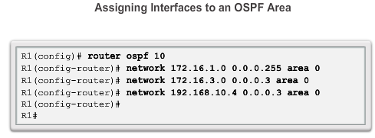
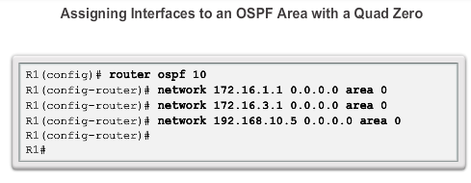
Configure Single-area OSPFv2 The network Command
Locally directly connected Networks
Quad 0 wildcard mask.
Uses the interface IP with the quad 0 mask. Entering network 172.16.3.1 0.0.0.0 area 0 on R1 tells the router to enable interface Serial0/0/0 for the routing process.
The advantage of specifying the interface is that the wildcard mask calculation is not necessary.
OSPFv2 uses the interface address and subnet mask to determine the network to advertise.
Notes:
8.2.2.1/2/3

Slide 33
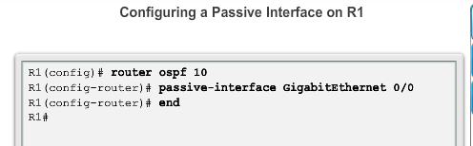
Configure Single-area OSPFv2 Configuring Passive Interfaces
Use the passive-interface router configuration mode command to prevent the transmission of routing messages through a router interface, but still allow that network to be advertised to other routers.
Inefficient Use of Bandwidth
Inefficient Use of Resources
Increased Security Risk
Notes:
8.2.2.5

Slide 34
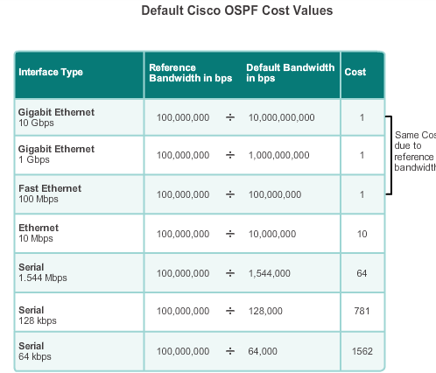
OSPF Cost OSPF Metric = Cost
Cost = reference bandwidth / interface bandwidth
(default reference bandwidth is 10⁸)
Cost = 100,000,000 bps / interface bandwidth in bps
Notes:
8.2.3.1

Slide 35
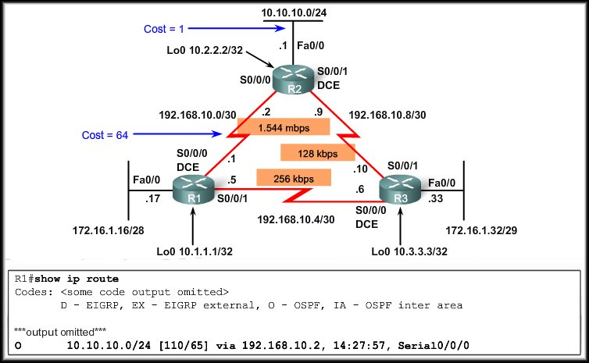
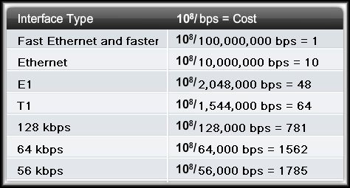
OSPF Accumulates Costs
Accumulated Cost = 65

Slide 36
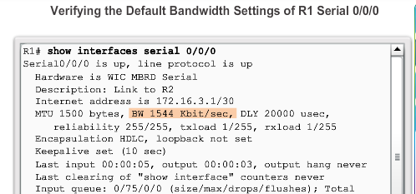
OSPF Cost Default Interface Bandwidths
On Cisco routers, the default bandwidth on most serial interfaces is set to 1.544 Mb/s
Notes:
8.2.3.4

Slide 37
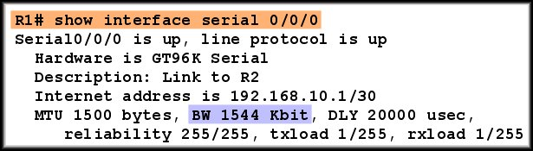
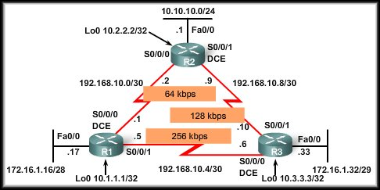
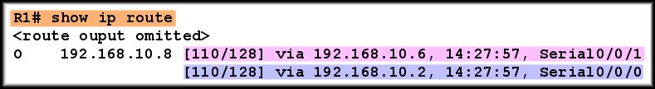
Default Bandwidth on Serial Interfaces
Both WAN links have defaulted to 1544 Kbit and have a cost of 128.

Slide 38
Default Bandwidth on Serial Interfaces
Interface S0/0/1 is actually the better path.
R1 believes it has two equal cost paths to network 192.168.10.8/30.

Slide 39
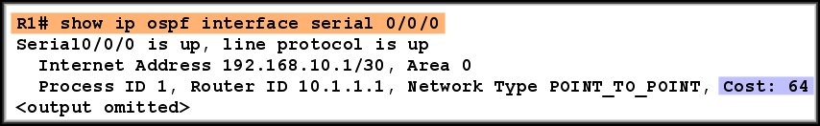
Default Bandwidth on Serial Interfaces
The calculated OSPF cost of an interface can be verified with the show ip ospf interface command.
As we have seen, this is NOT the cost of a 64 Kbps link.
Bandwidth can be changed using following command:

Slide 40
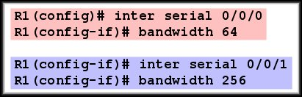
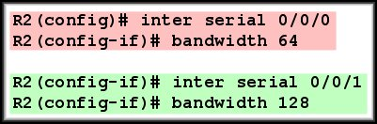
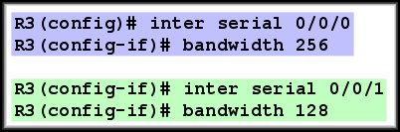
Modifying the Cost of a Link

Slide 41
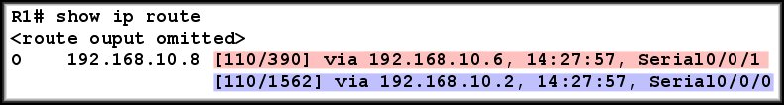
Modifying the Cost of a Link
The faster 256 Kbps link becomes the preferred route.

Slide 42
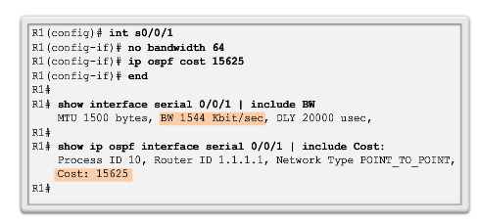
OSPF Cost Manually Setting the OSPF Cost
Both the bandwidth interface command and the ip ospf cost interface command achieve the same result, which is to provide an accurate value for use by OSPF in determining the best route.
Notes:
8.2.3.6

Slide 43


Verify OSPF
The show ip ospf command can also be used to examine the OSPF process ID and router ID, as shown in Figure 1. This command displays the OSPF area information and the last time the SPF algorithm was calculated.
show ip ospf neighbor Verify that the router has formed an adjacency with its neighboring routers
Notes:
8.2.4.1

Slide 44

Verify OSPF Verify OSPF Protocol Settings
Notes:
8.2.4.2

Slide 45

Verify OSPF Verify OSPF Interface Settings
Notes:
8.2.4.4

Slide 46
Configuring Single-area OSPFv3
Notes:
8.3

Slide 47

OSPFv2 vs. OSPFv3 OSPFv3
OSPFv3 is the OSPFv2 equivalent for exchanging IPv6 prefixes.
Notes:
8.3.1.1

Slide 48

OSPFv2 vs. OSPFv3 Similarities Between OSPFv2 to OSPFv3
Notes:
8.3.1.2

Slide 49

OSPFv2 vs. OSPFv3 Differences Between OSPFv2 to OSPFv3
In OSPFv3, OSPF messages are sourced using the link-local address of the exit interface.
All OSPF router multicast addresses- OSPFv2 uses 224.0.0.5; whereas, OSPFv3 uses FF02::5.
Notes:
8.3.1.3

Slide 50

OSPFv2 vs. OSPFv3 Link-Local Addresses
FF02::5 address is the all OSPF router address
FF02::6 is the DR/BDR multicast address
Notes:
8.3.1.4

Slide 51


Configuring OSFPv3 OSPFv3 Network Topology
Notes:
8.3.2.1

Slide 52

Configuring OSFPv3 Link-Local Addresses
Link-local addresses are automatically created when an IPv6 global unicast address is assigned to the interface (required).
Global unicast addresses are not required.
Cisco routers create the link-local address using FE80::/10 prefix and the EUI-64 process unless the router is configured manually, EUI-64 involves using the 48-bit Ethernet MAC address, inserting FFFE in the middle and flipping the seventh bit. For serial interfaces, Cisco uses the MAC address of an Ethernet interface.
Notice in the figure that all three interfaces are using the same link-local address.
Notes:
8.3.2.2

Slide 53


Configuring OSFPv3 Assigning Link-Local Addresses
Configuring the link-local address provides the ability to create an address that is recognizable and easier to remember
Notes:
8.3.2.3

Slide 54

Configuring OSFPv3 Configuring the OSPFv3 Router ID
Highest IPv6 address cannot be used as Router ID.
OSPFv3 requires a 32-bit router ID to be assigned before OSPF can be enabled on an interface.
Must be manually assigned.
Notes:
8.3.2.4

Slide 55

Configuring OSFPv3 Configuring the OSPFv3 Router ID
Notes:
8.3.2.4

Slide 56


Configuring OSFPv3 Modifying Verifying an OSPFv3 Router ID
Notes:
8.3.2.5

Slide 57

OSPF Configuring OSFPv3 Enabling OSPFv3 on Interfaces
Instead of using the network router configuration mode command to specify matching interface addresses, OSPFv3 is configured directly on the interface. (Easier?)
To enable OSPFv3 on an interface, use the
ipv6 ospf process-id area area-id
Notes:
8.3.2.6

Slide 58


Verify OSPFv3 Verify OSPFv3 Neighbors/Protocol Settings
FULL state means that the router and its neighbor have identical OSPF LSDBs.
Dead Time - The amount of time remaining that the router waits to receive an OSPF Hello packet from the neighbor before declaring the neighbor down. This value is reset when the interface receives a Hello packet.
Interface - The local interface on which this router has formed adjacency with the neighbor.
Notes:
8.3.3.1/2

Slide 59

Verify OSPFv3 Verify OSPFv3 Interfaces
Notes:
8.3.3.3

Slide 60

Verify OSPFv3 Verify IPv6 Routing Table
Notice the Next Hop Address is the Link Local Address of the router
Notes:
8.3.3.4

Slide 61


